Slide 1
Weekly meeting
5 16 2024
Ty Bottorff

Slide 2
Outline
Figure by figure comparison/reproducing/extending Erin’s P452 to P576

Slide 3
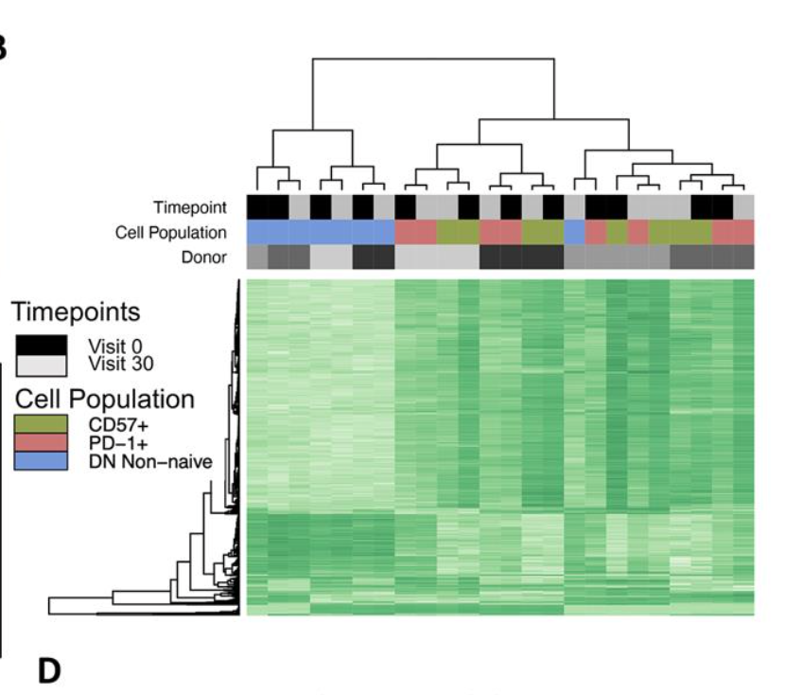
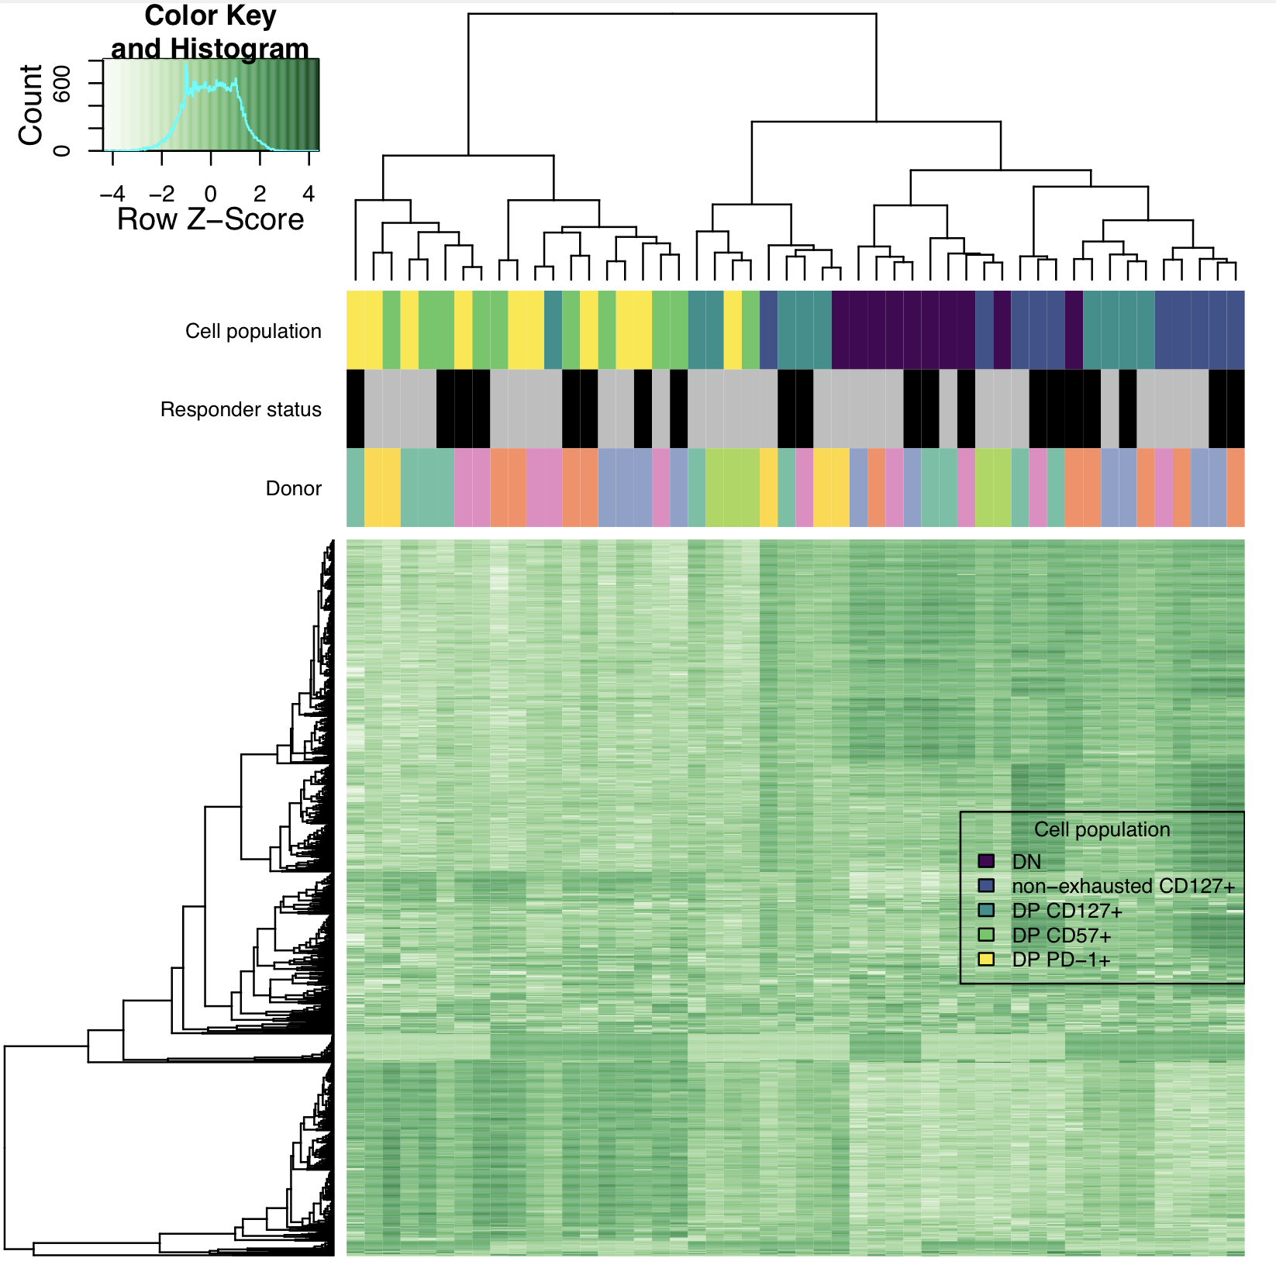
DP CD57⁺ and DP PD-1⁺ cluster together, away from DN in both projects, DP CD127⁺ seems to cluster separately (as do DN/non-exhausted CD127⁺) in P576
P576
P452 (Erin’s)

Slide 4
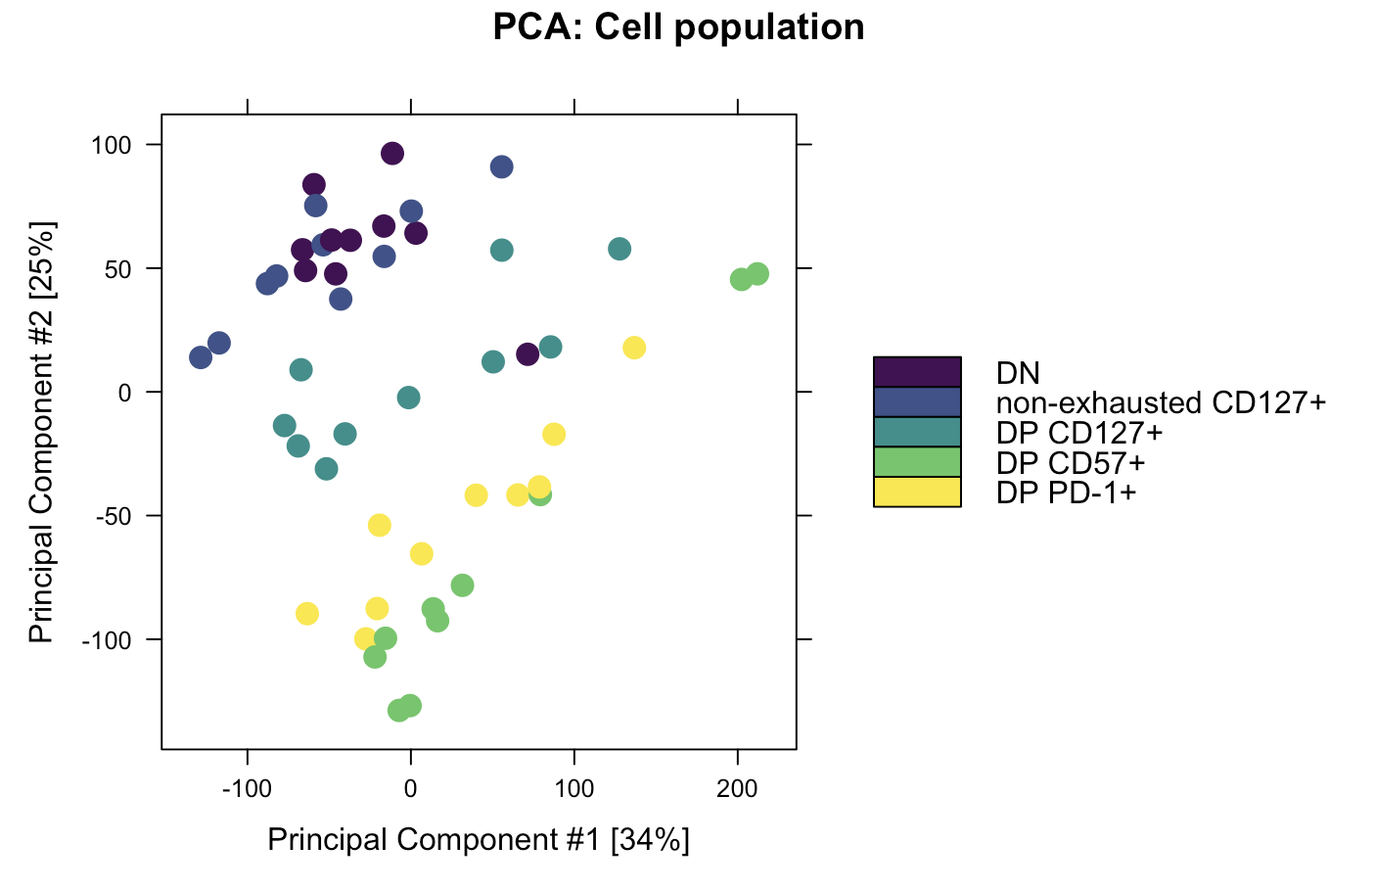
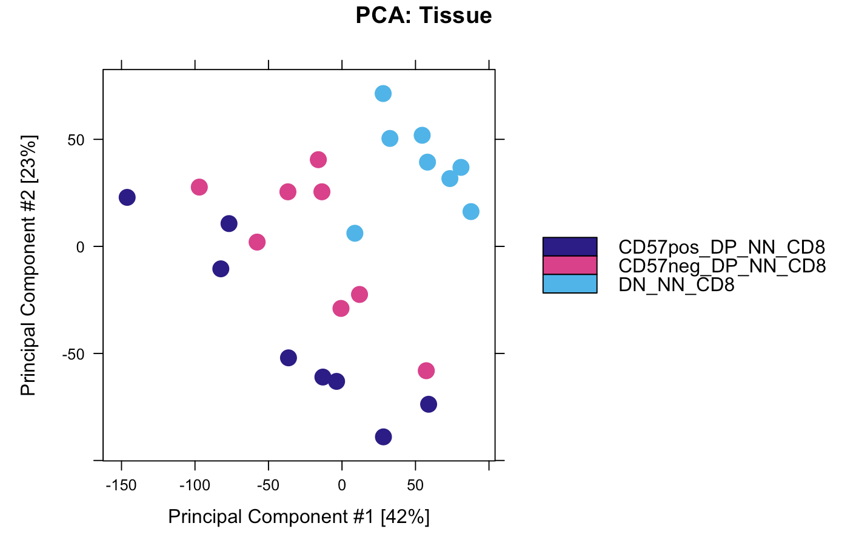
DP CD57⁺ and DP PD-1⁺ cluster together, away from DN in both projects, DP CD127⁺ seems to cluster separately (as do DN/non-exhausted CD127⁺) in P576
P576
P452 (Erin’s)
Notes:
Rows in heatmap are peaks?

Slide 5
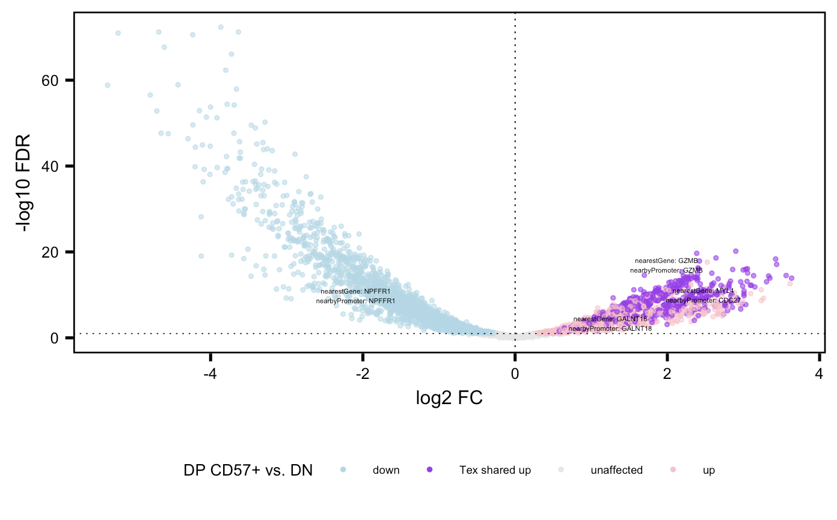
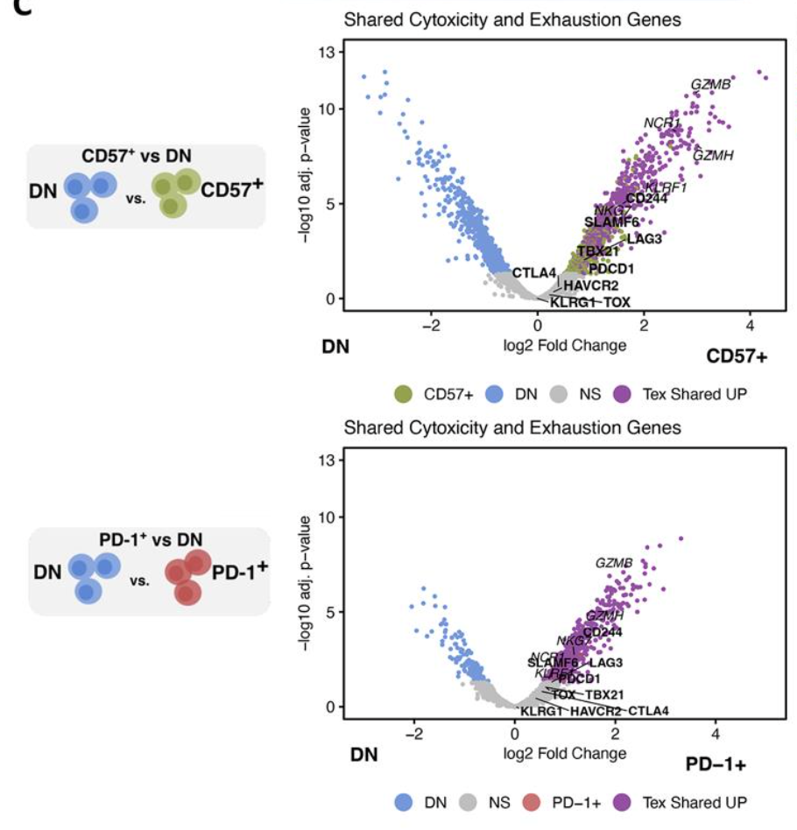
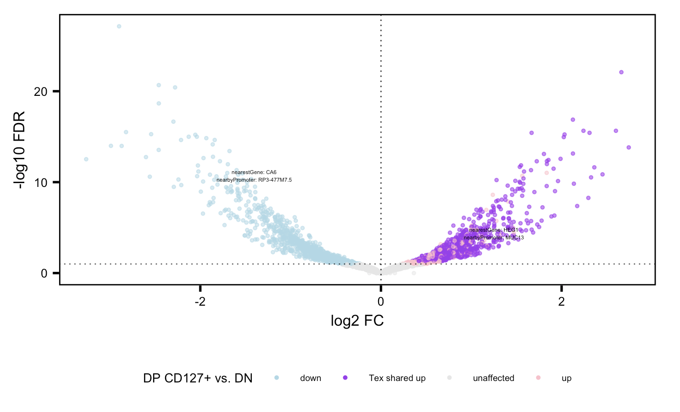
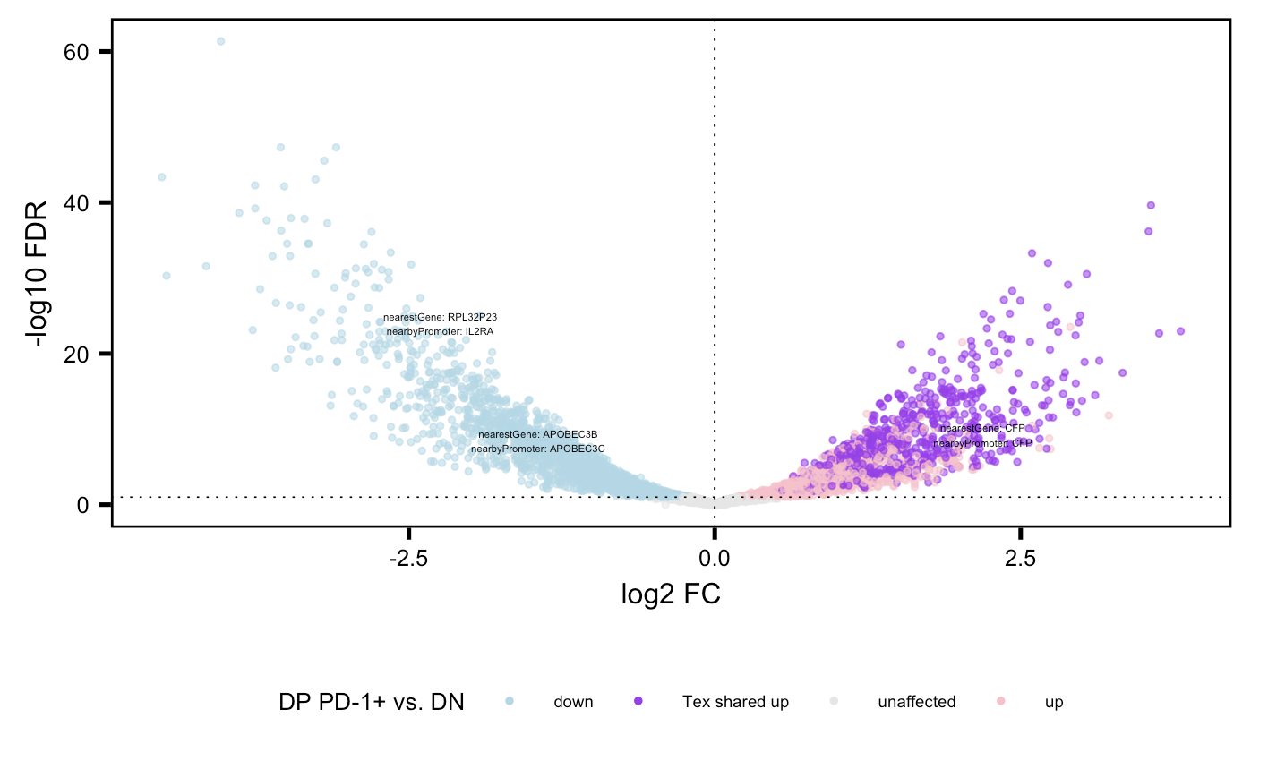
Substantial closest gene to peak sharing between DP populations in both projects
P452
P576
Notes:
Methods:
1. Filter peaks for positive log2 FC and FDR < 0.05 in each sort vs. DN
2. then look for genes appearing at least once in all 3 lists = T_{ex} shared “up”
3. also filter peaks for VP by top abs(FC) for each gene (looks similar if by median FC peak)
Haven’t done but expect promoter colored purple/peak filtered to look similar

Slide 6
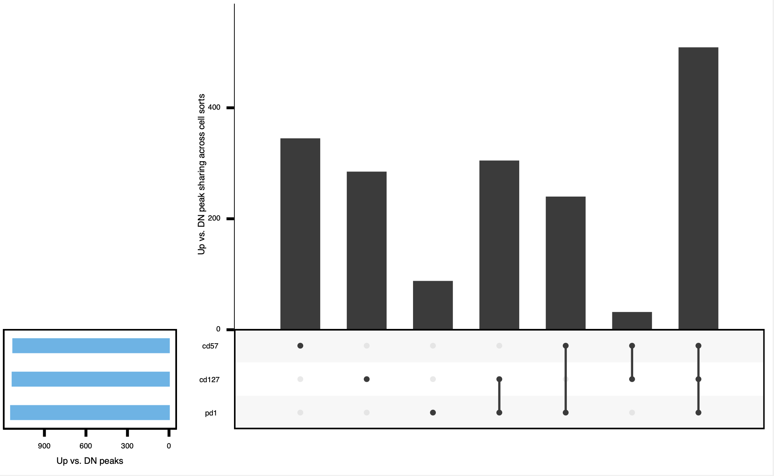
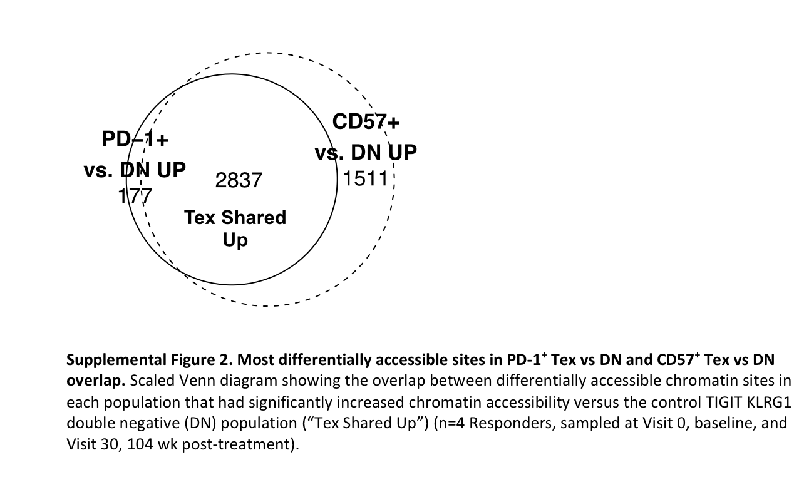
T_{ex} peak sharing points to DP PD-1⁺ being intermediate population, this ~agrees with PCA but still expected more sharing between DP PD-1⁺ and DP CD57⁺ and less sharing between DP CD127⁺ and others
P452
P576
Standardized set sizes to that of minimum (took top FCs for each DP vs. DN)
Notes:
Looks similar for promoter or just peak (genomic position) rather than gene
KIRs aren’t present in the unique to DP CD57⁺ fraction (not surprising, they don’t show up vs. DN, only vs. DP PD-1⁺)

Slide 7
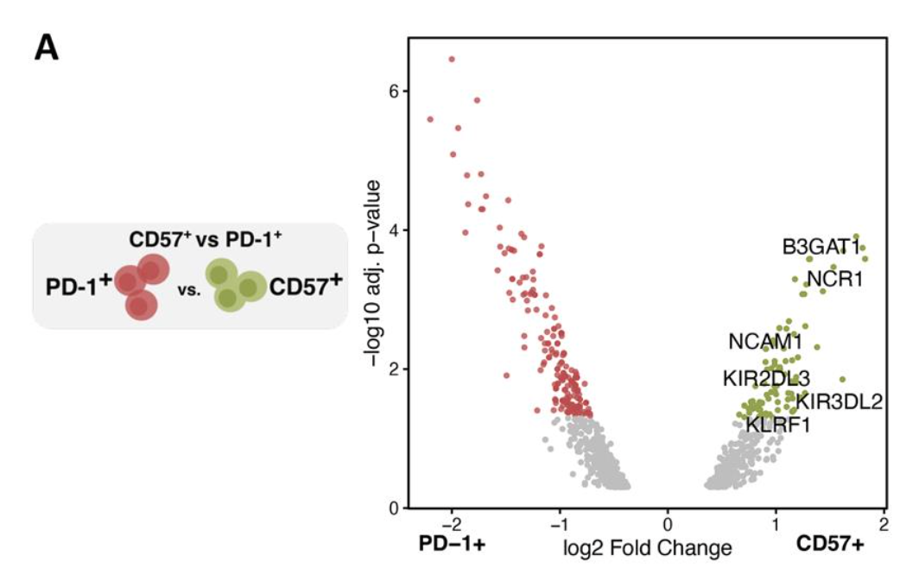
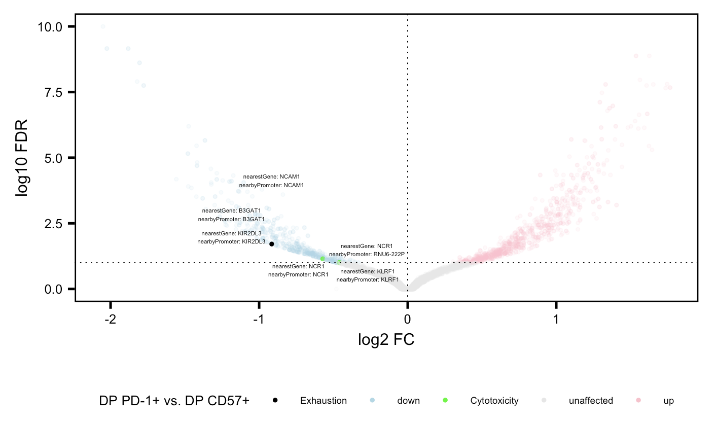
DP CD57⁺ vs. DP PD-1⁺ VP similar between projects
P452
P576

Slide 8
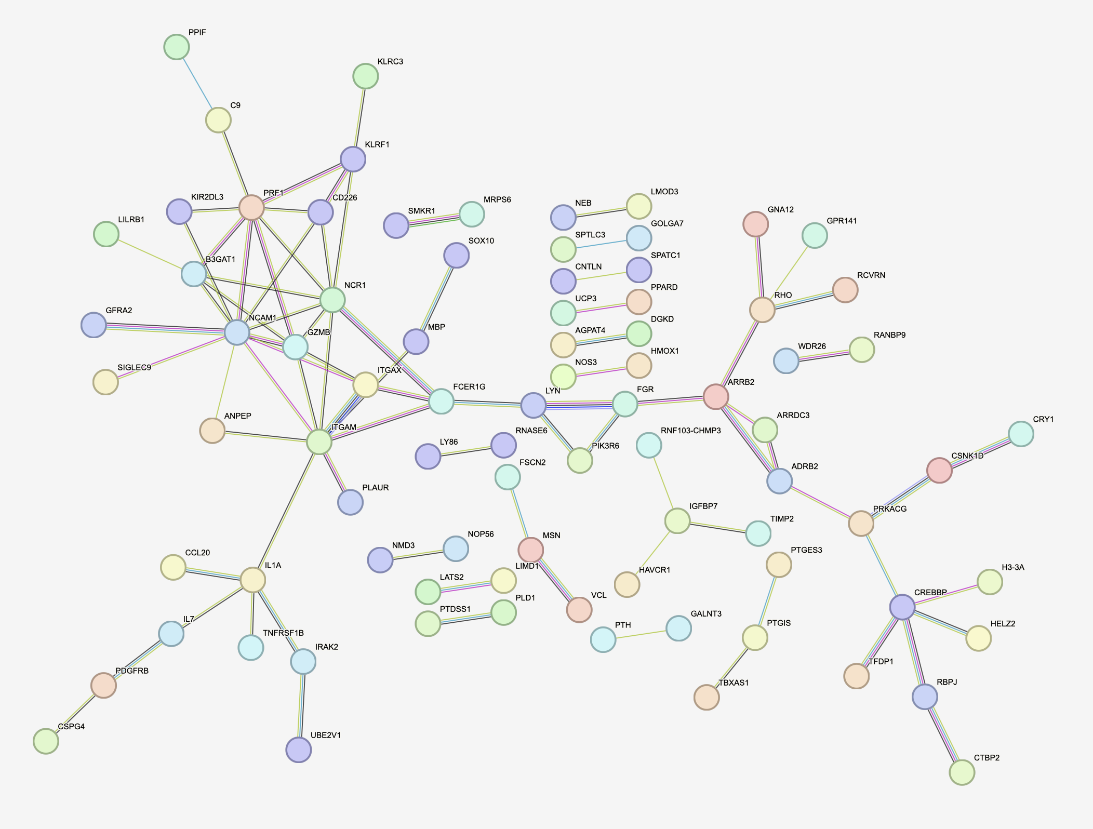
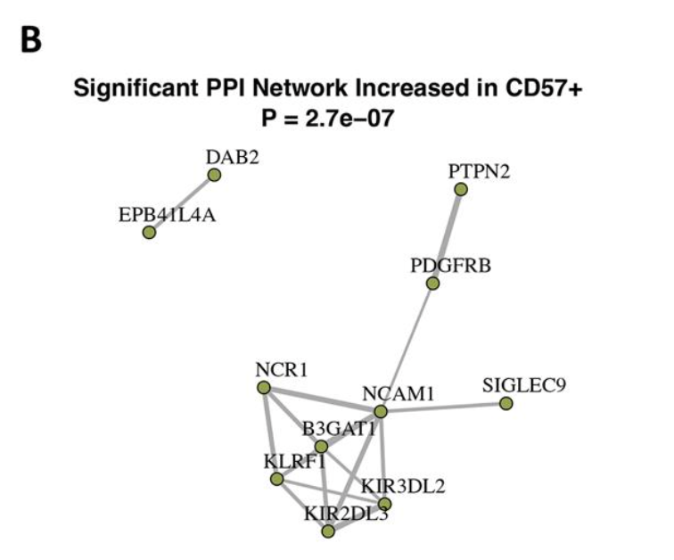
PPI network shows similar NCAM1—NCR1-KIR2DL3-B3GAT1 hub across projects for peaks up in DP CD57⁺ vs. DP PD-1⁺
Genes, p = 0.0002
P452
P576

Slide 9
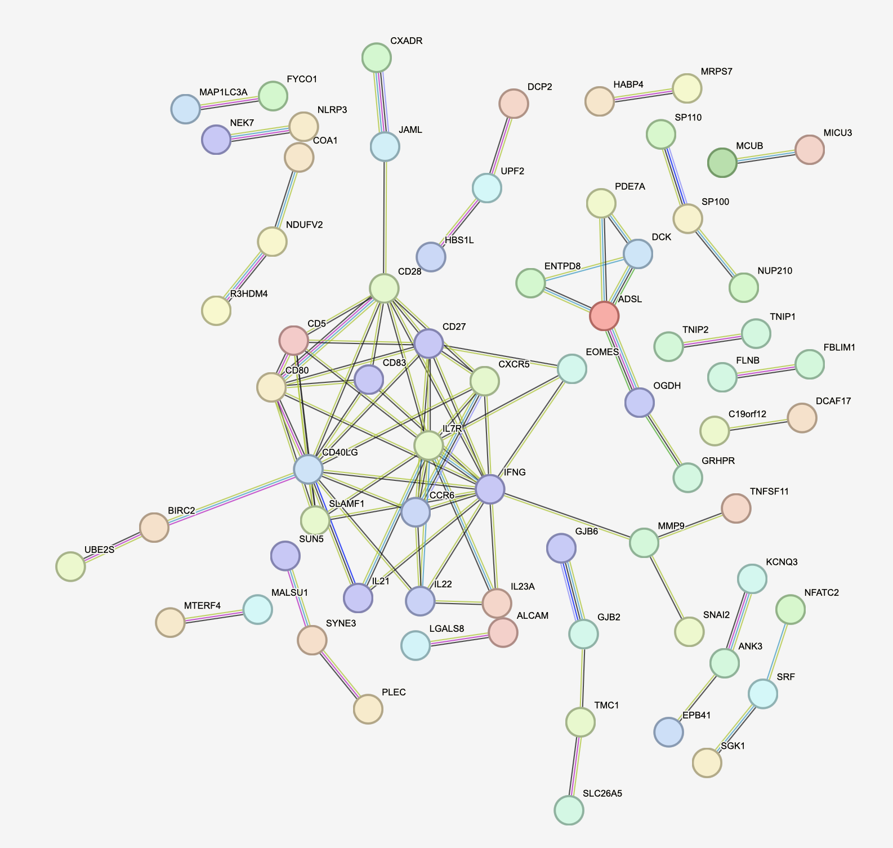
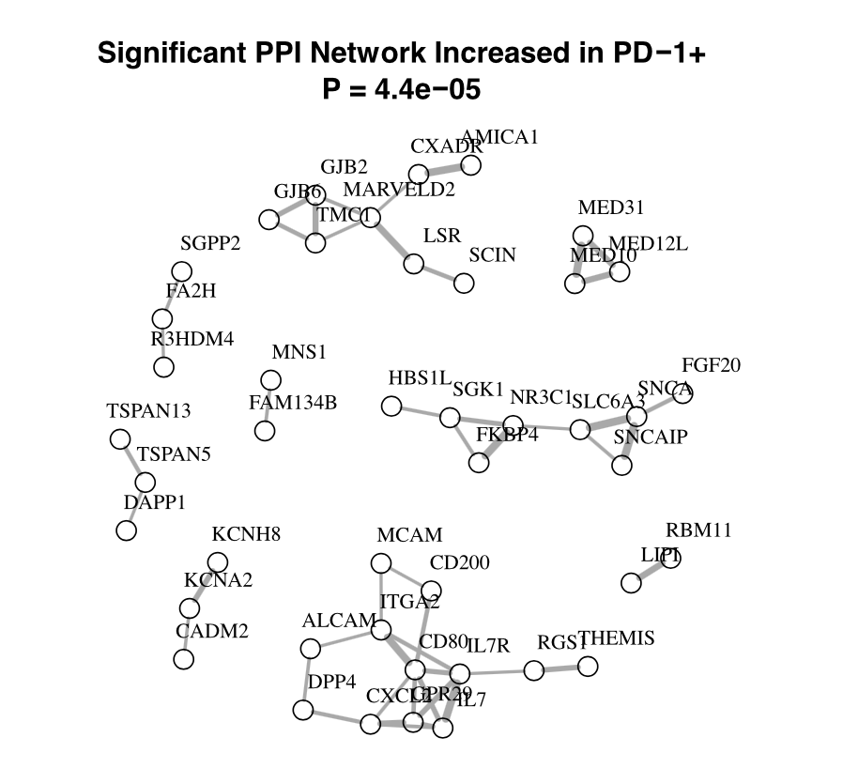
PPI network doesn’t show similar structure across projects for peaks up in DP PD-1⁺ vs. DP CD57⁺
Genes, p = 2e-6
P452
P576

Slide 10
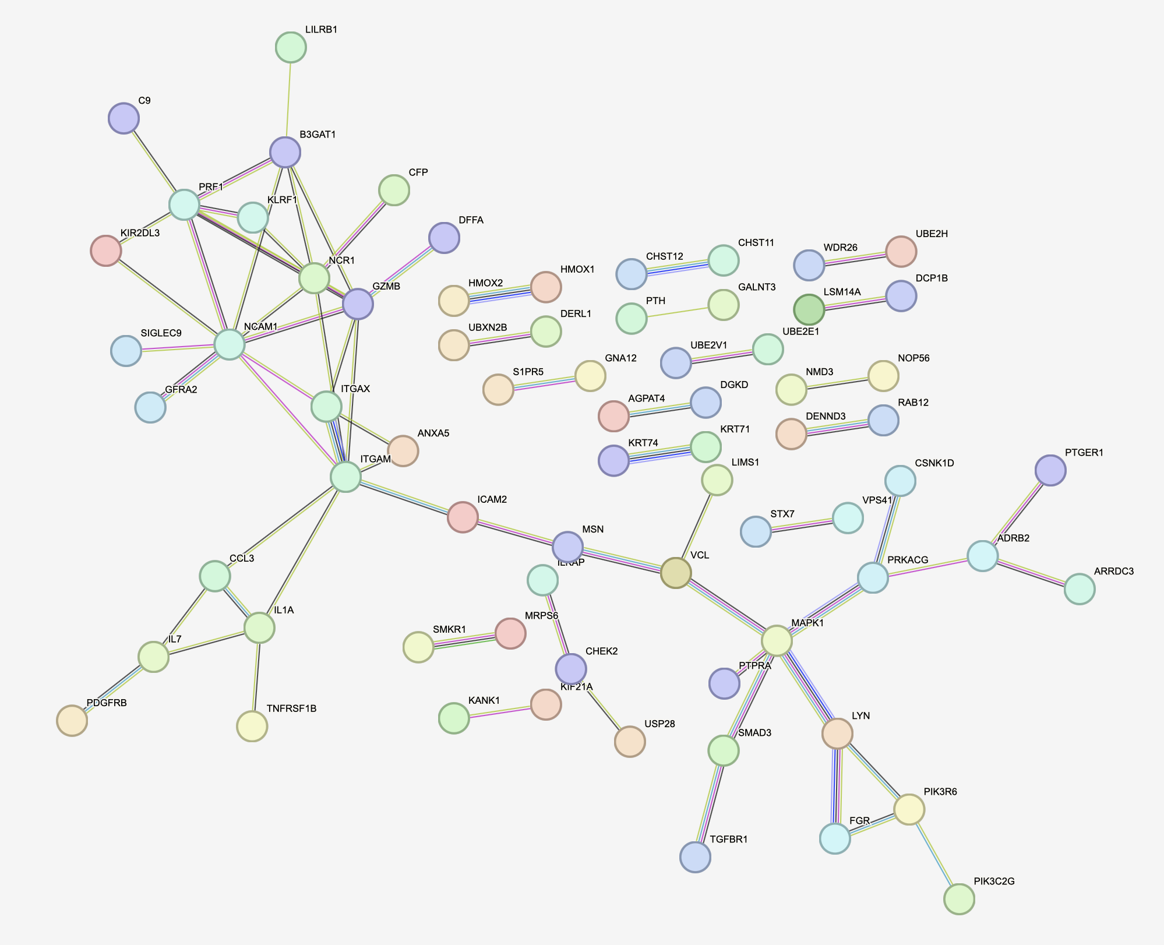
KIRs also seem to distinguish DP CD57⁺ vs. DP CD127⁺

Slide 11
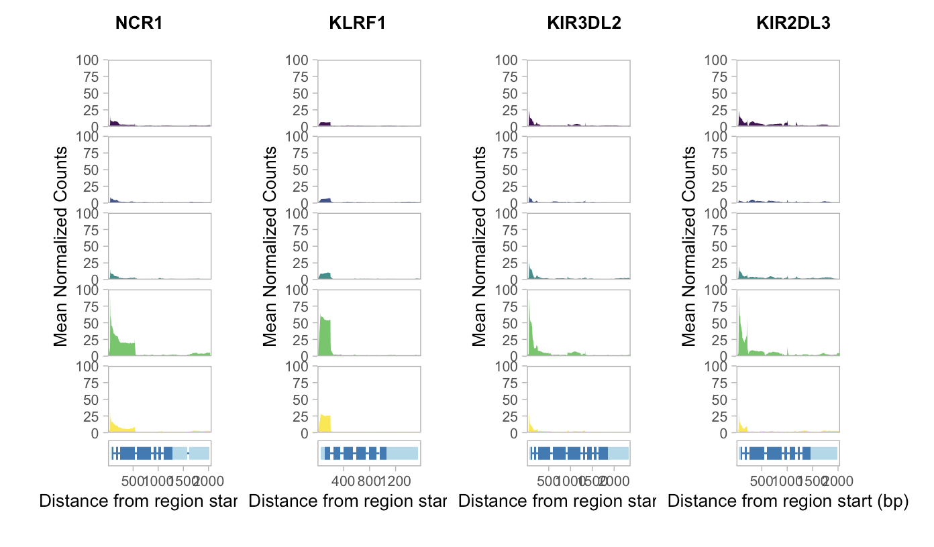
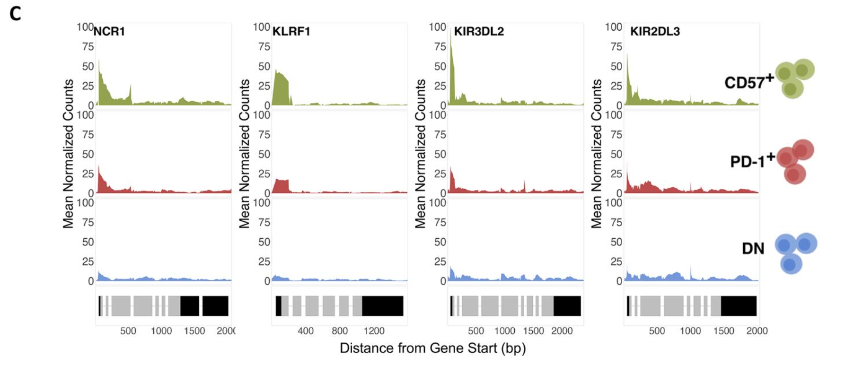
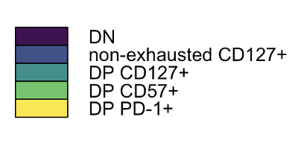
DP CD57⁺ accessible genes accessible in both projects

Slide 12
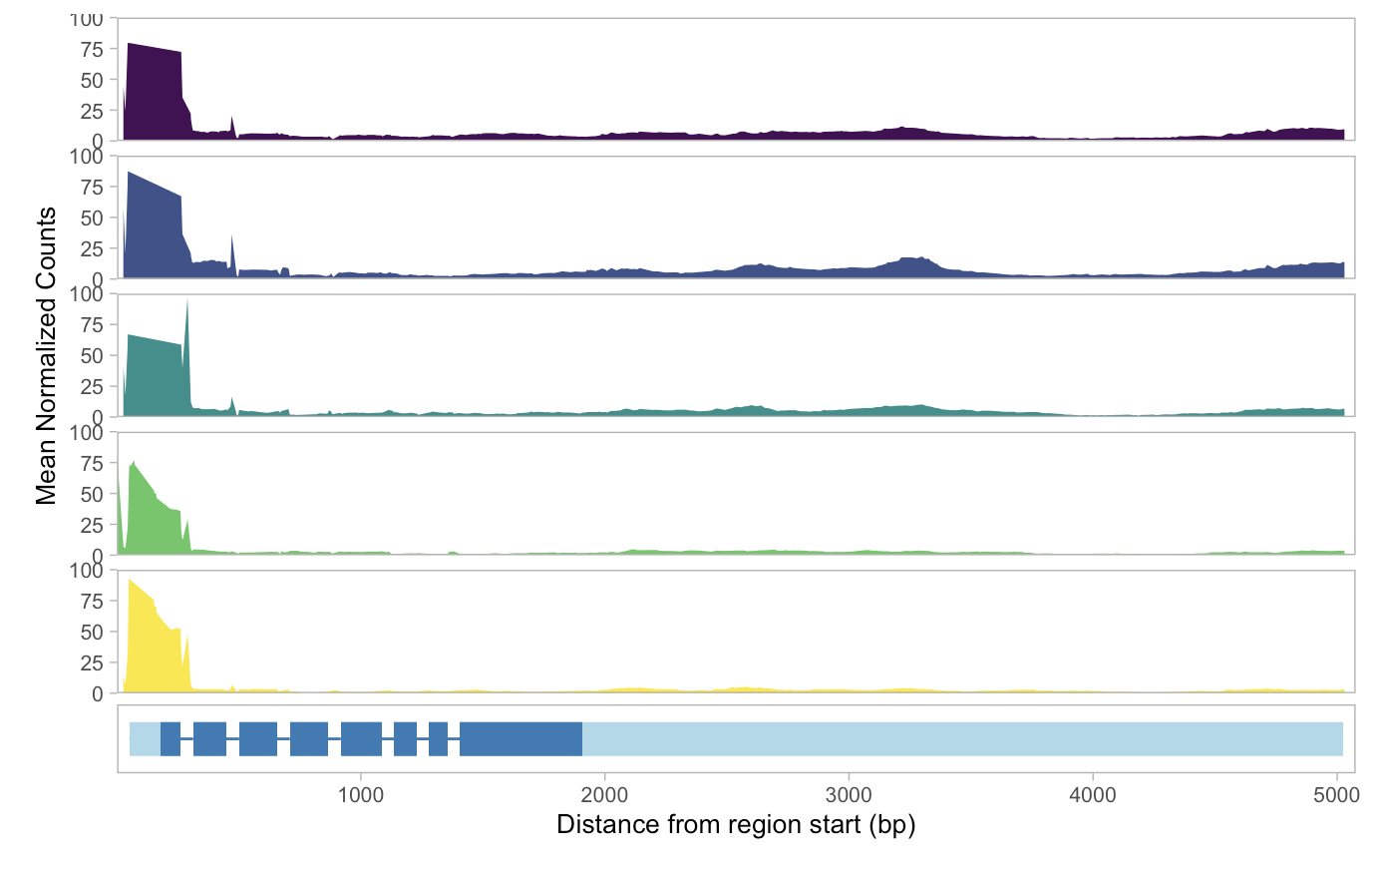
Start of CD127 gene similarly accessible in all populations, gene more accessible in DN and CD127⁺

Slide 13
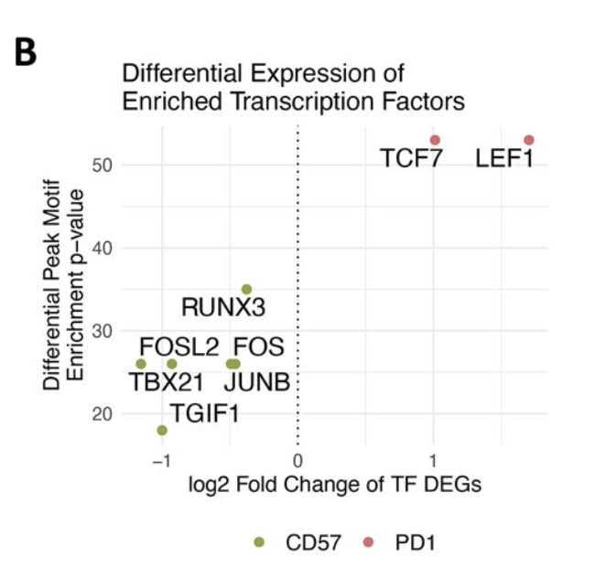
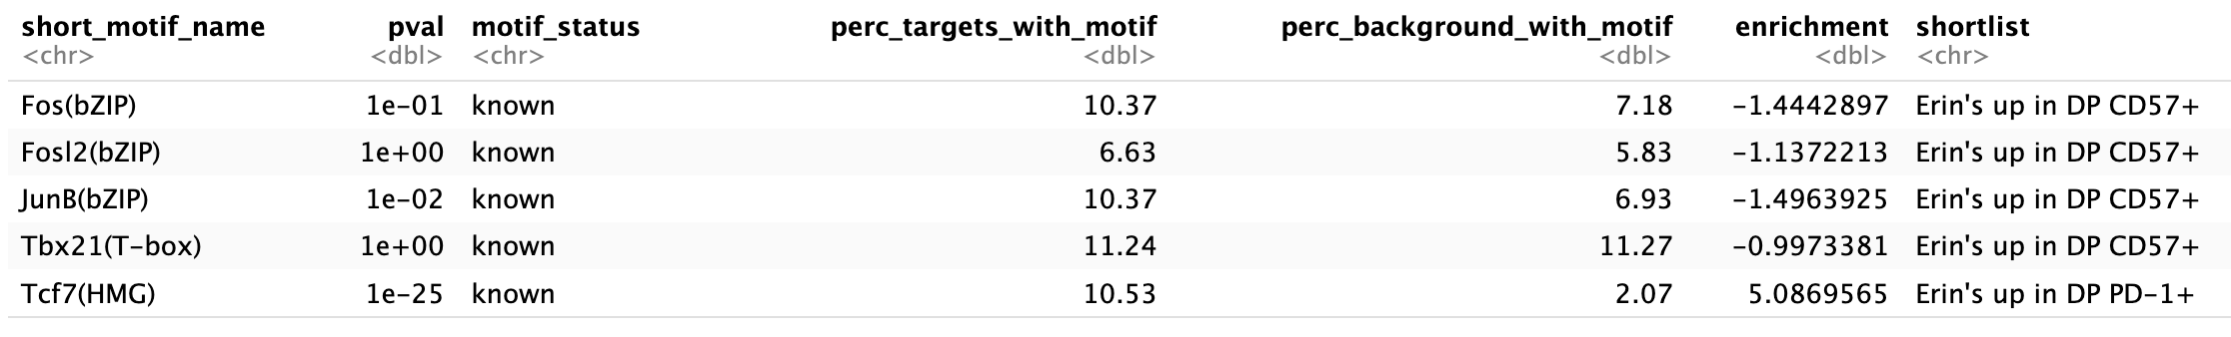
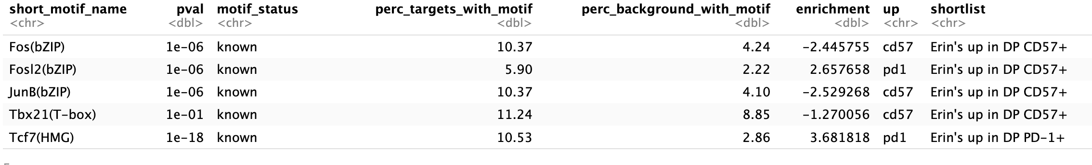
Specific DAR background may contribute to differences between project analyses
+ enrichment = up in DP PD-1⁺ (in my hands)
- enrichment = up in DP CD57⁺ (in my hands)
Genomic background
DAR background, Fosl2 is unexpectedly up in DP PD-1⁺
took highest pval for each TF (sometimes saw same TF in both directions)
Notes:
Do see more of Erin’s CD57 TFs in CD57 vs. DN but here Erin does CD57 vs. PD-1 and vice versa

Slide 14
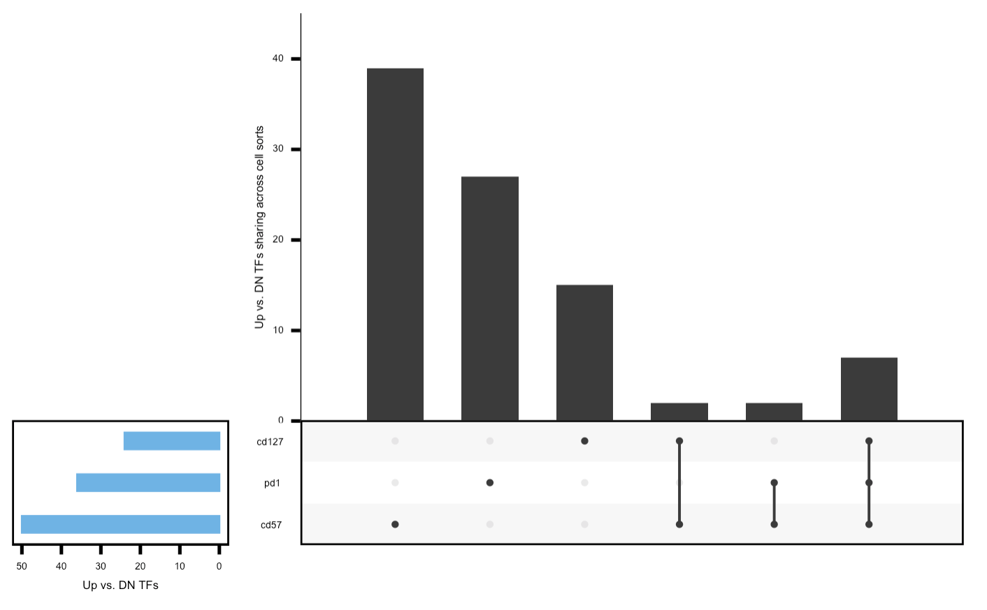
DP vs. DN TF sharing still doesn’t help show which DPs are closer in lineage
Changes from last week:
Lower pval filter (1e-12 as Erin did)
Included de novo motifs
Standardizing set size doesn’t help interpret
DAR background
Notes:
Background for motif discovery: peaks up in DN vs. each DP

Slide 15
Conclusions
Projects generally have similar results when applicable
DP PD-1⁺ and DP CD57⁺ close in lineage by PCA/heatmap clustering, DP PD-1⁺ intermediate to DP CD127⁺ and DP CD57⁺ by peak sharing vs. DN

Slide 16
Next steps
Prepare for code review
Prepare for SI (sending slides Tues after code review?)
QC
PCAs (colored by donor, R/NR, cell population)
Heatmap (of peaks as shown here, also of genes’ mean accessibilities across cell populations? Haven’t tried yet)
VPs (DPs vs. DN, DP vs. DP)
Peak sharing across DP vs. DN
PPIs
Mean coverage plots

Slide 17
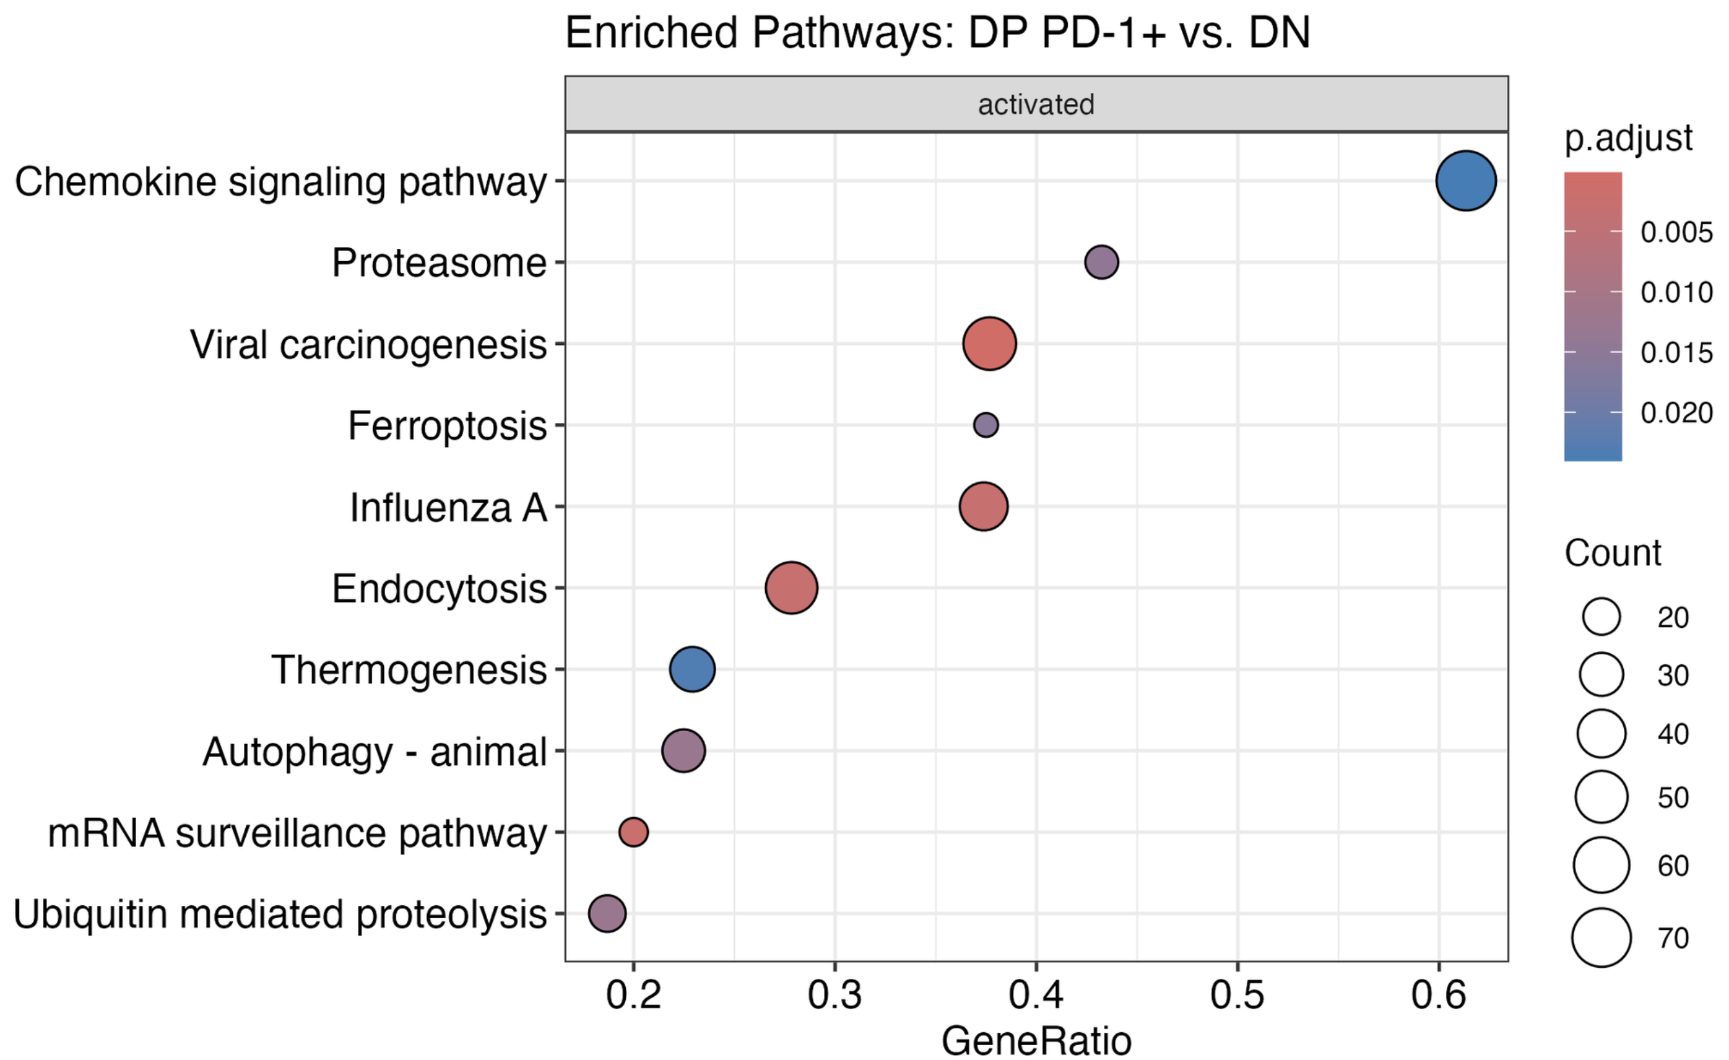
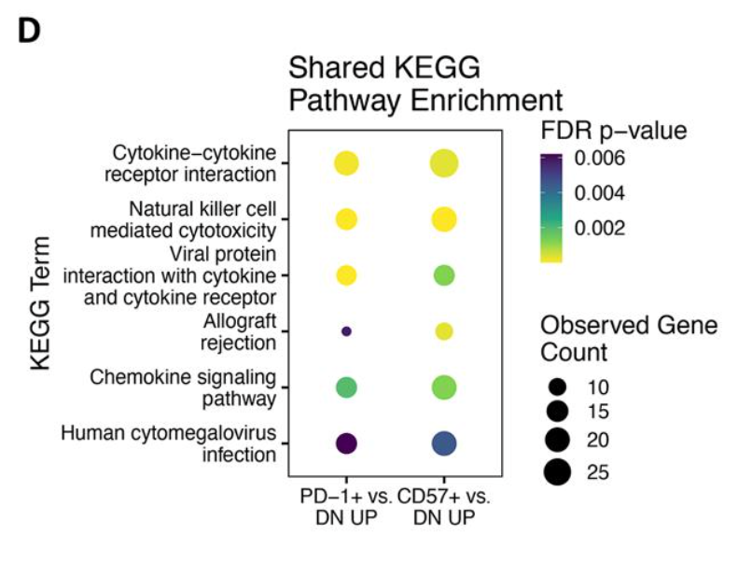
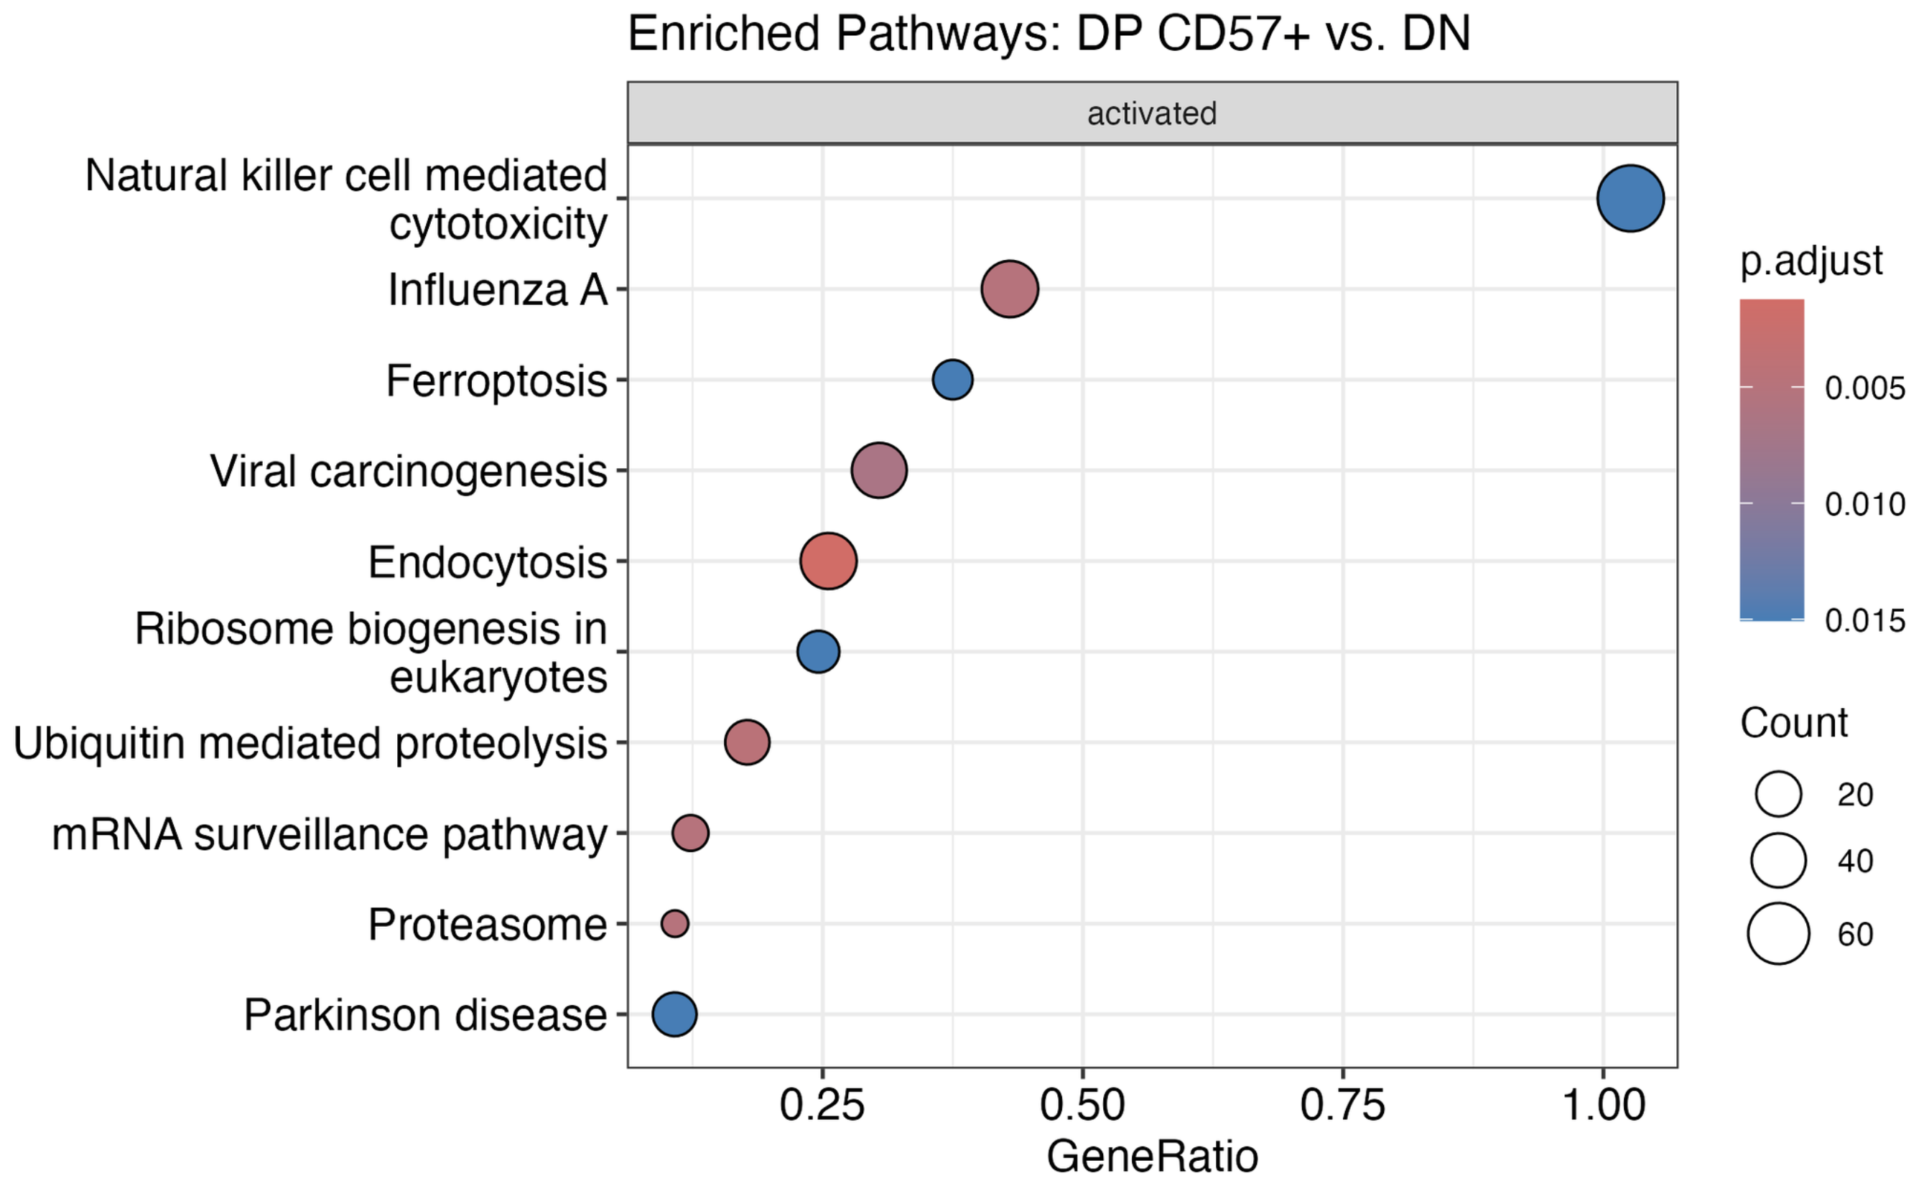
KEGG results are not very well reproduced, likely due to different methods
P452
P576

